Slide 1
Architectural Styles and Case Studies
UNIT 2a

Slide 2

Reference

Slide 3
Agenda
Architectural styles
Pipes and filters
Data abstraction and object-oriented organization
Event-based
Implicit invocation
Layered systems
Repositories
Interpreters
Process control
Other familiar architectures
Heterogeneous architectures
Case Studies
Keyword in Context
Instrumentation software
Mobile robotics
Cruise control
Three vignettes in mixed style.

Slide 4
Introduction
Software Systems
are more complex & bigger
are not just about “algorithms” anymore
Challenges
– structural issues
– communication (type, protocol)
– synchronization
– data access & manipulation
– deployment
– performance
– testing

Slide 5
Issues
Are the boxes representing running programs?
Or chunks of source code?
Or physical computers?
Or merely logical groupings of functionality?
Are the arrows representing compilation dependencies?
Or control flows?
Or data flows?
Usually it is a bit of everything!

Slide 6

Why?
Recognize common patterns
build new systems as variation on old systems
Selecting the right architecture
crucial to success

Slide 7
Examples

Slide 8
Architectural Styles
An architectural style is a description of component and connector types and a pattern of their runtime control and/or data transfer.
Examples:
main program with subroutines
data abstraction
implicit invocation
pipes and filters
repository (blackboard)
layers of abstraction

Slide 9
Contd.
Architecture Anatomy
component: represents computation (work)
connectors: facilitates component communication
Architectural Style/Configuration
architecture = {components, connectors, constraints}
Visualization
graph representation

Slide 10
Alexander’s patterns
There is abundance evidence to show that high buildings make people crazy.
High buildings have no genuine advantage, except in speculative gains. They are not cheaper, they do not help to create open space, they make life difficult for children, they wreck the open spaces near them. But quite apart from this, empirical evidence shows that they can actually damage people’s minds and feelings.
In any urban area, keep the majority of buildings four stories high or less. It is possible that certain buildings should exceed this limit, but they should never be buildings for human occupancy.

Slide 11
General flavor of a pattern
IF you find yourself in <context>, for example <examples>, with <problem>
THEN for some <reasons>, apply <pattern> to construct
a solution leading to a <new context> and <other
patterns>

Slide 12
Components and Connectors
Components are connected by connectors.
They are the building blocks with which an architecture can be described.
No standard notation has emerged yet.

Slide 13
Types of Components
computational: does a computation of some sort. E.g. function, filter.
memory: maintains a collection of persistent data. E.g. database, file system, symbol table.
manager: contains state + operations. State is retained between invocations of operations. E.g. server.
controller: governs time sequence of events. E.g. control module, scheduler.

Slide 14
Types of Connectors
Procedure call (including RPC)
Data flow (e.g. pipes)
Implicit invocation
Message passing
Shared data (e.g. blackboard or shared data base)
Instantiation

Slide 15
1. Pipes and Filters
Overview
Architectural pattern for stream processing
A filter defines a processing/computation step
Data flows through a sequential chain of filters
A filter chain represents a system

Slide 16
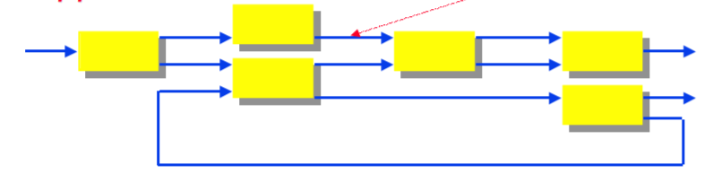
Pipes and Filters…
Components (Filters)
● set of inputs and outputs
● input & output streams
● local transformation
– incremental output
Connectors (Pipes)
● facilitate data flow
I/O

Slide 17
Contd.
Invariants
Filters (or components) are independent entities
do not share state
have no knowledge of other filters
Data transformation
incremental
not dependent on order in the chain

Slide 18
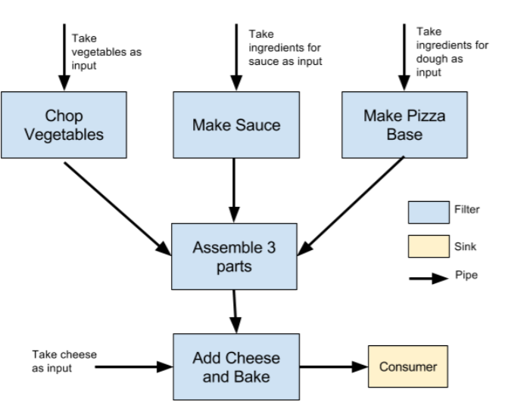
Example-1 : Pizza

Slide 19
Example-2
Unix shell programs
pipelines (cat file1 | sort | grep keyword)
ls -l | tee file.lst | wc -l
This will create a file (file.lst) containing the result from ls -l and will display the number of files to the screen (or pass it on to another filter, if you require).

Slide 20
Example-3
JEE Servlet Filter (javax.servlet.Filter)

Slide 21
Example-4
Compilers
more of a sequential batch architecture

Slide 22
Advantages
Simple composition
Reuse - any two filters can be combined together as long as they speak the same data language
Prototyping
how many scripts make use of grep, awk, sed etc?
Easy growth & evolution (how?)
Architectural evaluation for performance & bottlenecks
Naturally support concurrency & parallelism

Slide 23
Disadvantages
Poor performance
each filter has to parse data
sharing global data is difficult
Not appropriate for interaction
Low fault tolerance threshold
what happens if a filter crashes
Data transformation
to LCD to accommodate filters
increases complexity & computation

Slide 24
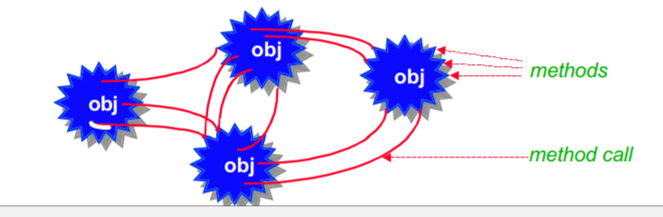
2. Data Abstraction
Object Oriented Organization (OOO)
encapsulation (data & operations)
division of responsibility
Components
objects, modules (its own data)
discrete, independent, loosely coupled
Connectors
represent inter-object communication : synchronous or asynchronous
via messaging : – method calls
interface
property access methods

Slide 25
Key Aspects
Objects preserve their integrity
No direct access
Object representation is a private affair
Functional composition
Objects can be assembled from other objects
Inheritance & polymorphism

Slide 26
Advantages
Possible to change implementation of an object without affecting its clients
Decomposition
large system into a set of interacting objects
easy to manage & evolve
Highly cohesive
Extensible (Reuse)
via inheritance & polymorphism

Slide 27
Disadvantages
Interaction == coupling
objects interact via public contract
what happens when the contract changes?
indirect coupling:
A uses B, C uses B, then changes made by C on B are unexpected to A
For an object to interact with another, it must know its identity (not in pipe & filter architectures)
When the methods of an object change, so must all other objects that use this object

Slide 28
3. Implicit Invocation/Event Based
Instead of invoking a procedure directly, a component can announce one or more events (such as arrival of data or execution of an operation)
Other components in the system can register an interest in an event by associating a procedure with the event
On <event> if <condition> then <action>
On arrive(D) if D < a or D ≥ b then print(“out of bounds”)
Such procedures are also called triggers, actors or event-condition-action (ECA) rules

Slide 29
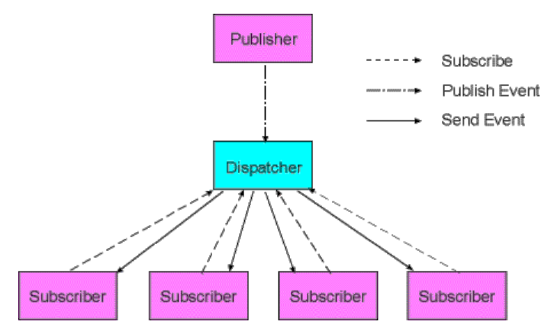


Event-based…
Components
modules {event, callback procedure}
objects, processes, distributed applications
Connectors
traditional method call
broadcast of events
Publish & Subscribe
components register for events
events are generated/published by different sources to a centralized system
events are broadcast via callback or procedure

Slide 30
Examples
News, fire alarms, etc.
Model view controller (MVC)
Integrated development environments (IDE)
Database systems to
ensure consistency constraints
execute stored procedures
User interface
separation of data presentation from data management
Enterprise application interaction
Instant messaging (WhatsApp, FB Messaging, Viber, etc.)

Slide 31
Advantages & Disadvantages
An advantage of event-based invocation is that it encourages reuse
a component can be introduced in a system simply by registering it for the events of that system
A drawback is that sometimes event-based systems become quite unpredictable and hard to control.

Slide 32
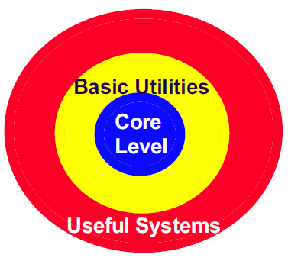
4. Layered Systems
A layered system is organized hierarchically, each layer serving the layer above.
Best examples of layered software systems are layered communication protocols.
Layered systems support design based on increasing levels of abstraction. However, not all systems can be structured in a layered fashion

Slide 33
Contd.
Components: layers, each layer usually contains several programs
Connectors: typically procedure calls
Basic Idea
Each layer exposes an interface (API) to be used by the layer above it
Each layer acts as a
Server: service provider to layer “above”
Client: service consumer of the layer “below”

Slide 34
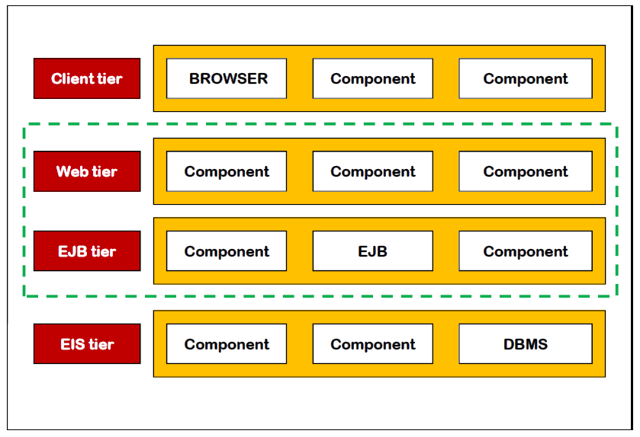
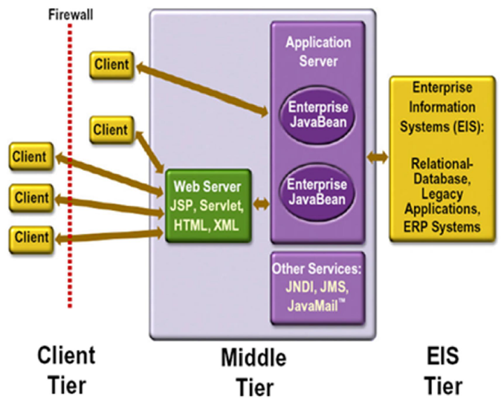
Example: J2EE Multi-tier

Slide 35
Advantages & Disadvantages
Advantages
Clear dependence structure benefits evolution
Lower layers are independent from the upper layers
Upper layers can evolve independently from the lower layers as long as the interface semantics is unchanged
Strict layering: limits propagation of change
Reuse − e.g., standardized layer interfaces for libraries/frameworks
Disadvantages
Not universally applicable
Performance (mostly for strict layering and many layers)

Slide 36
5. Repository Style (Blackboard)
A repository architecture consists of a central data structure (often a database) and a collection of independent components which operate on the central data structure.
Components
A central data structure representing the current state of the system.
A collection of independent components that operate on the central data structure.
Connectors
Typically procedure calls or direct memory accesses.

Slide 37
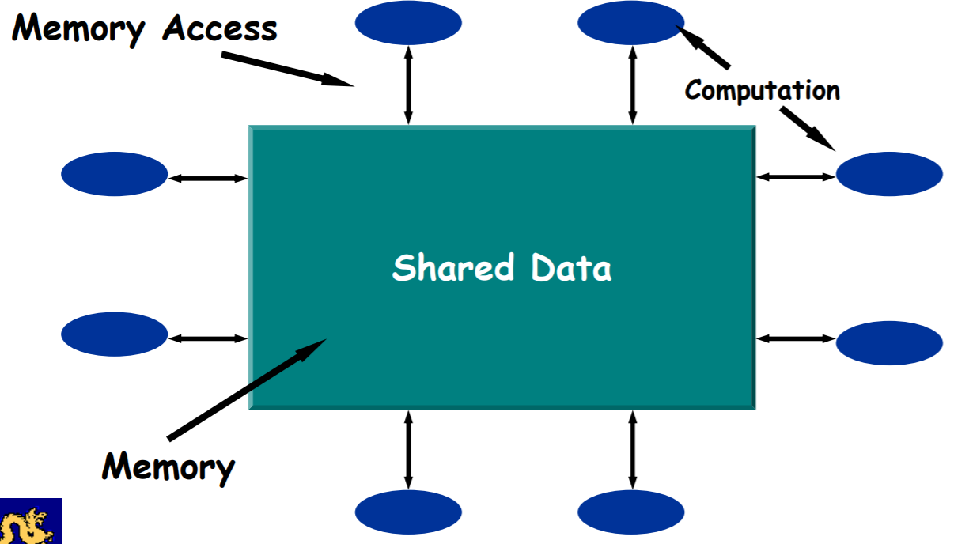
Contd.
Blackboard

Slide 38
Example
Chat Participant
Chat Participant
Chat Participant
Chat Transcript
Chat Participant
Chat Participant

Slide 39
Examples
Signal processing: Speech & Pattern recognition
Information Systems
Programming Environments
Graphical Editors
Software Design
AI Knowledge Bases
Reverse Engineering Systems

Slide 40
Advantages
Efficient way to store large amounts of data.
Sharing model is published as the repository schema.
Software Design
Centralized management:
backup
security
concurrency control

Slide 41
Disadvantages
Must agree on a data model a priori.
Difficult to distribute data.
Data evolution is expensive.

Slide 42
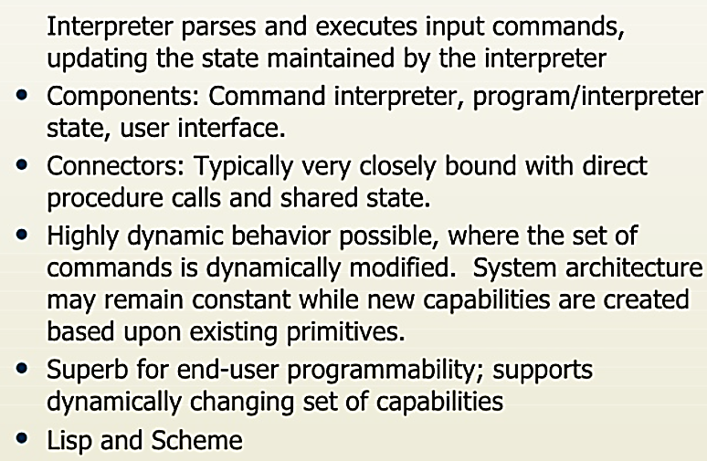
6. Interpreter Style
Java, SmallTalk, Prolog, Coral, Awk, Perl

Slide 43
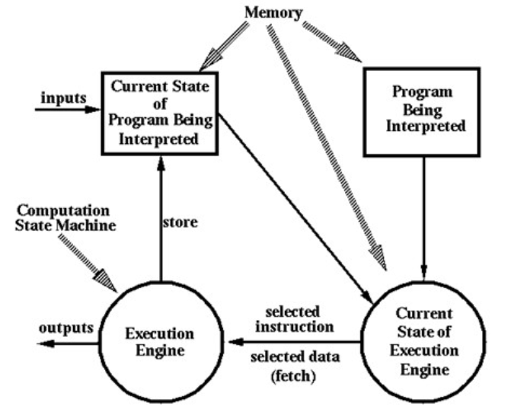
Interpreter

Slide 44
Advantages & Disadvantages
Advantages
Simulation of non-implemented hardware.
Facilitates portability of application or languages across a variety of platforms.
Disadvantages
Extra level of indirection slows down execution.
Java has an option to compile code.
JIT (Just In Time) compiler.

Slide 45
Java Program Execution
RAM
JVM
foo1.class
Class Loader
Byte Code Verifier
Execution Engine
foo2.class
foo3.class
JIT Code Generator

Slide 46
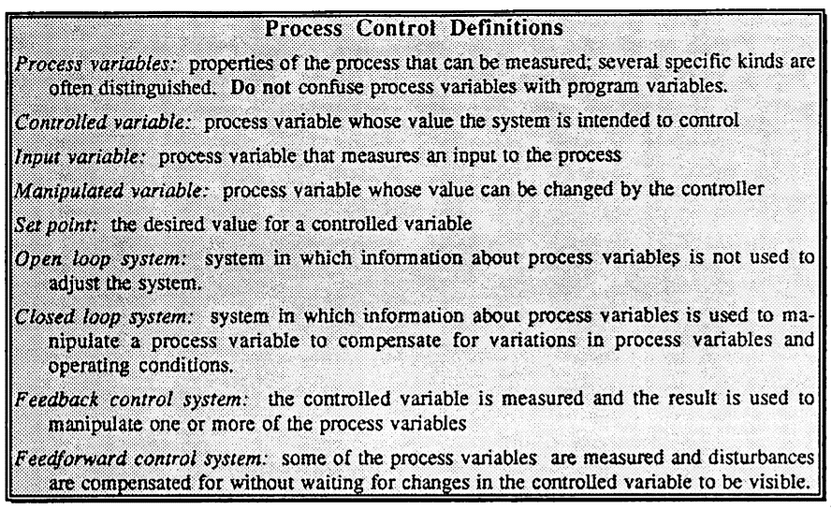
7. Process Control Paradigm
Convert input materials to products with specific properties by performing operations on the inputs and on intermediate products.

Slide 47
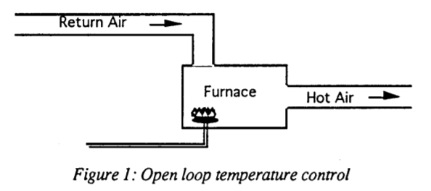
Open Loop Temperature Control
If the input materials are pure, if the process is fully-defined, and if the operations are completely repeatable, the process can simply run without surveillance. Such a process is called an open loop system.

Slide 48
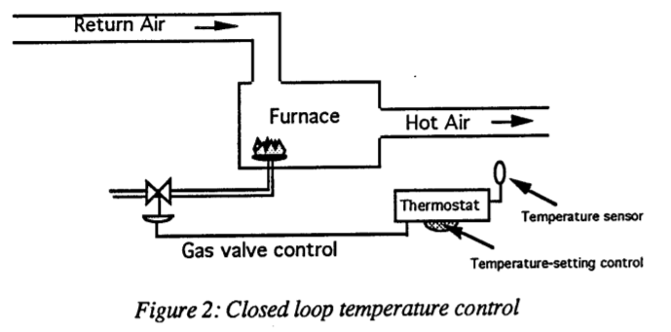
Closed Loop
The temperature, pressure and flow rates are monitored, and their values are used to control the process by changing the settings of apparatus such as valves. heaters, and chillers.
Such systems are called closed loop systems

Slide 49
Software Paradigm
Algorithmic view: compute outputs for some given inputs.
This is open-loop model
If operating conditions of software is unpredictable, then algorithmic approach fails.
Controlled architecture is needed.

Slide 50
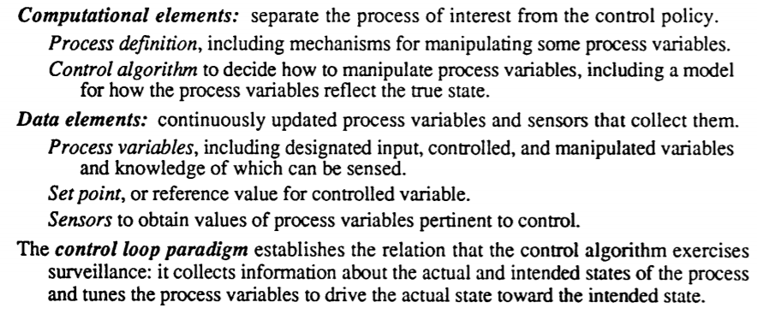
Contd…

Slide 51
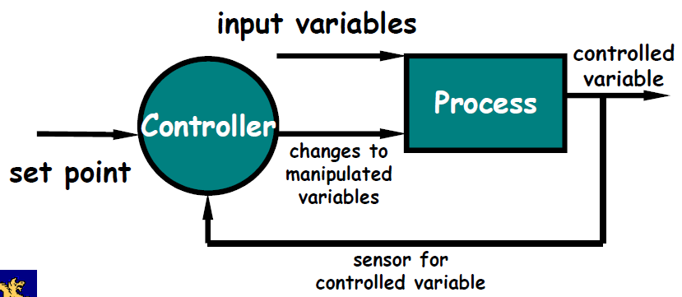
Components
Process Definition includes mechanisms for
manipulating some process variables.
Control Algorithm for deciding how to
manipulate process variables

Slide 52
Connectors
Process Variables
Controlled variable whose value the system is intended to control.
Input variable that measures an input to the process.
Manipulated variable whose value can be changed by the controller.
Set Point is the desired value for a controlled variable
Sensors to obtain values of process variables pertinent to control.

Slide 53
Other Architectures
Distributed Processes: Ex. Client-Server
The Common Object Request Broker Architecture (CORBA) is a standard distributed object architecture developed by the Object Management Group (OMG) consortium.
CORBA objects can
be located anywhere on the network
interoperate with objects on other platforms
be written in a variety of programming languages

Slide 54
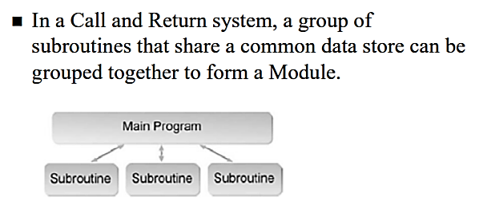
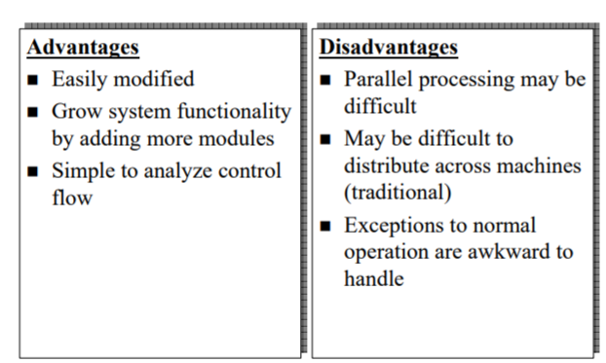
Main Program/Subroutine

Slide 55
Domain Specific SA
Defn: "an assemblage of software components, specialized for a particular type of task (domain), generalized for effective use across that domain, composed in a standardized structure (topology) effective for building successful applications“.
Examples of domains
Compilers
Consumer electronics
Electronic commerce system/Web stores
Video game
Business applications
Healthcare applications
Subdivision of a domain:
Avionics systems -> Boeing Jets -> Boeing 747-400

Slide 56
DSSA - Composition
A reference architecture, which describes a general computational framework for a significant domain of applications;
A component library, which contains reusable chunks of domain expertise;
An application configuration method for selecting and configuring components within the architecture to meet particular application requirements.

Slide 57
Heterogeneous Architectures
Heterogeneous System Architecture (HSA) is a cross-vendor set of specifications that allow for the integration of central processing units and graphics processors on the same bus, with shared memory and tasks.
Example: designing a satellite ground station for a representative satellite.
Ground station - receiving satellite telemetry, processing the telemetry, interacting with the users, and sending satellite commands.

Slide 58
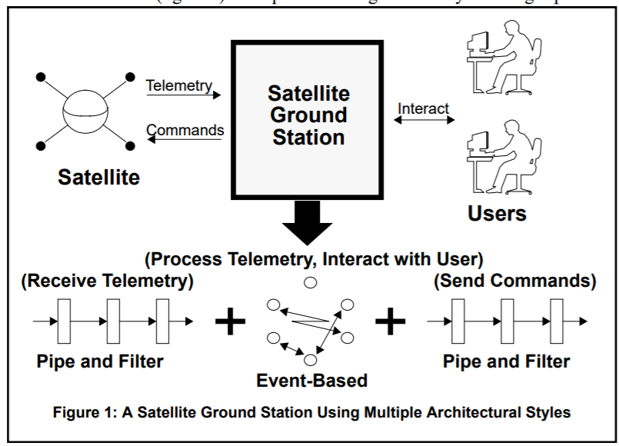
Example

Slide 59
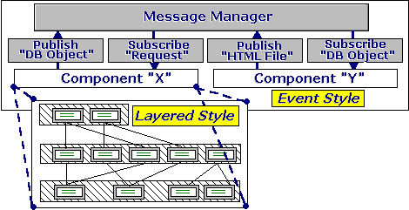
How to combine?
Hierarchically Heterogeneous means that a component of one style, when decomposed, is structured according to the rules of a different style
Example
An end-user interface sub-system might be built using Event System architectural style, while all other sub-systems − using Layered Architecture

Slide 60
Summary

